Slide 1
EART30351
Lecture 2

Slide 2
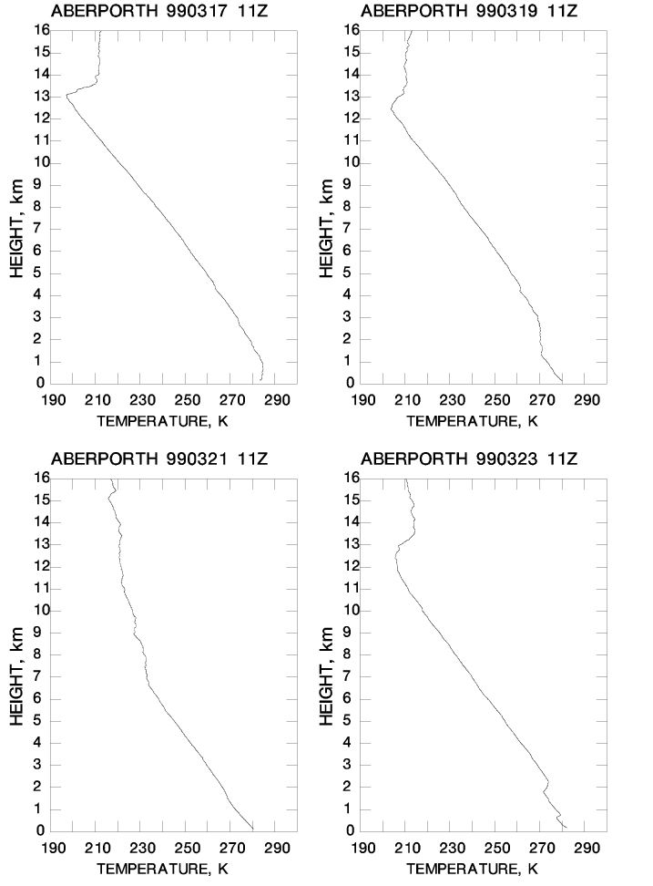
Examples of radiosonde profiles: temperature vs height
stratosphere
stratosphere
T
T
troposphere
troposphere
I
stratosphere
stratosphere
T
troposphere
T : tropopause;
I: inversion (top of boundary layer in this case)
T
Temperature generally decreases with height in the troposphere
troposphere
I

Slide 3
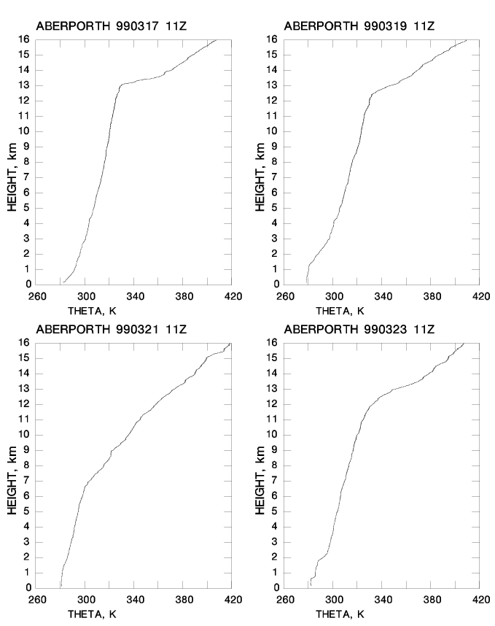
Examples of radiosonde profiles: potential temperature vs height
θ always increases with height

Slide 4
Why does θ increase with height?
Consider a parcel of air displaced in the vertical
Displacement is fast enough to be adiabatic so θ remains constant
And
Displacement is slow enough that w <<c_{s}, the speed of sound
So
θ = θ’’ and p’ = p’’
p'’,T’’,ρ’’,θ’’
p’,T’,ρ’,θ’
Δz
p,T,ρ,θ

Slide 5
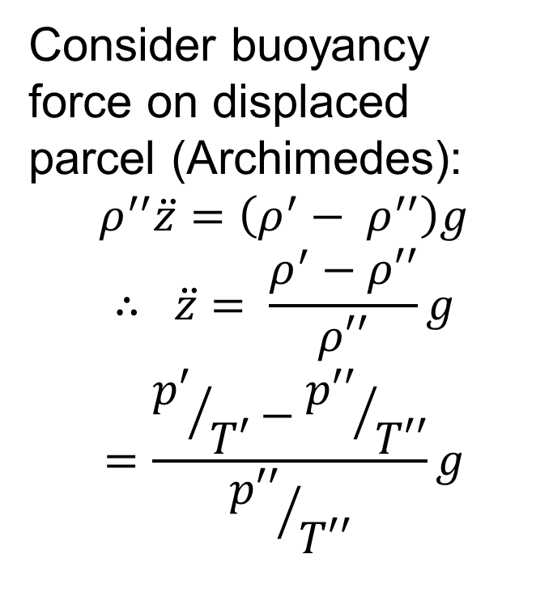
Static stability 1
Consider buoyancy force on displaced parcel (Archimedes):
$$ρ^{′′}\ddot{z}=\left(ρ^{′}− ρ^{′′}\right)g$$
$$∴ \ddot{z}= \frac{ρ^{′}−ρ′′}{ρ′′}g$$
$$=\frac{{p′}/{T′}−{p′′}/{T′′}}{{p′′}/{T′′}}g$$

Slide 6
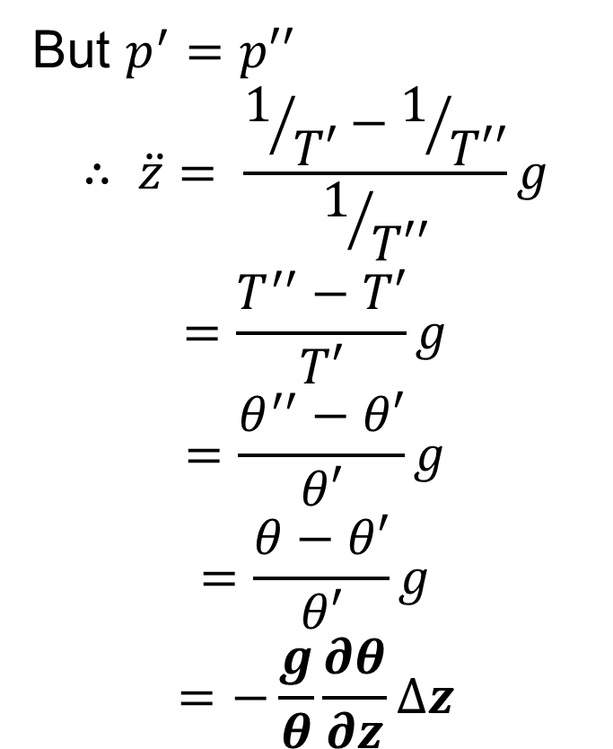
Static stability 1
Consider buoyancy force on displaced parcel (Archimedes):
$$ρ^{′′}\ddot{z}=\left(ρ^{′}− ρ^{′′}\right)g$$
$$∴ \ddot{z}= \frac{ρ^{′}−ρ′′}{ρ′′}g$$
$$=\frac{{p′}/{T′}−{p′′}/{T′′}}{{p′′}/{T′′}}g$$
But $p^{′}=p′′$
$$∴ \ddot{z}= \frac{1/{T′}−1/{T′′}}{1/{T′′}}g$$
$$=\frac{T^{′′}−T′}{T′}g$$
$$=\frac{θ^{′′}−θ′}{θ′}g$$
$$=\frac{θ−θ′}{θ′}g$$
$$=−\frac{g}{θ}\frac{∂θ}{∂z}∆z$$

Slide 7
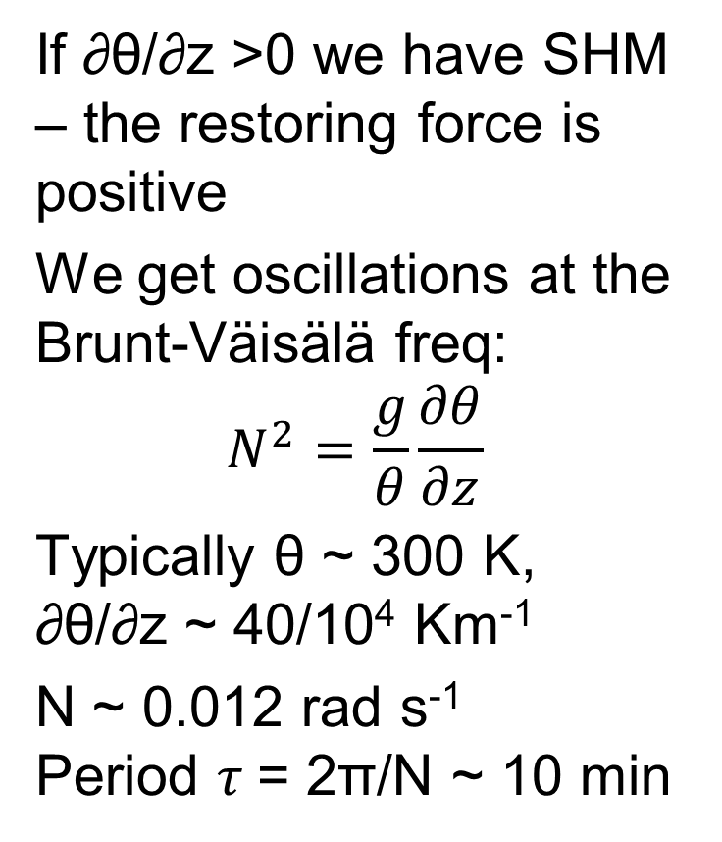
Static Stability 2
If ∂θ/∂z >0 we have SHM – the restoring force is positive
We get oscillations at the Brunt-Väisälä freq:
$$N^{2}=\frac{g}{θ}\frac{∂θ}{∂z}$$
Typically θ ~ 300 K, ∂θ/∂z ~ 40/10⁴ Km⁻¹
N ~ 0.012 rad s⁻¹ Period $τ$= 2π/N ~ 10 min

Slide 8
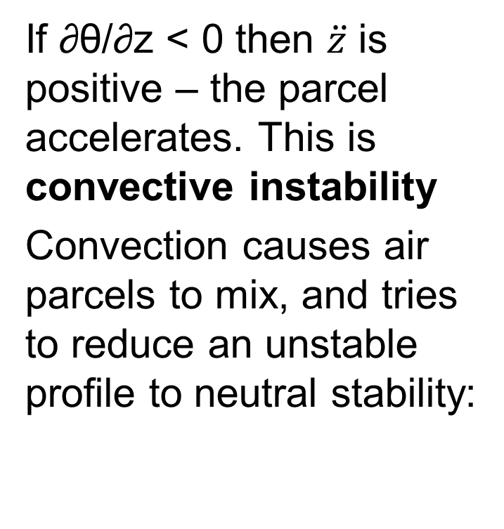
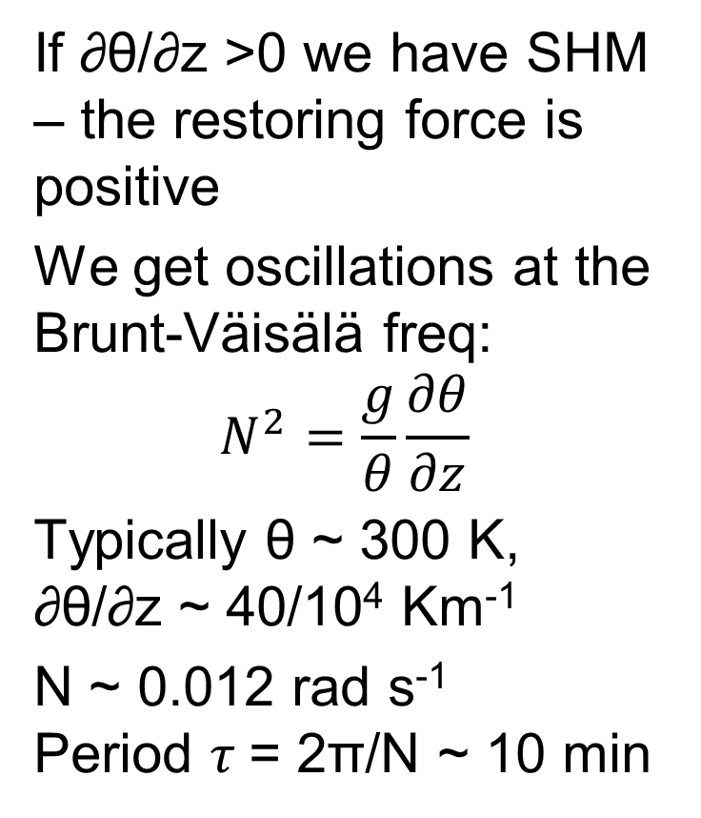
Static Stability 2
If ∂θ/∂z >0 we have SHM – the restoring force is positive
We get oscillations at the Brunt-Väisälä freq:
$$N^{2}=\frac{g}{θ}\frac{∂θ}{∂z}$$
Typically θ ~ 300 K, ∂θ/∂z ~ 40/10⁴ Km⁻¹
N ~ 0.012 rad s⁻¹ Period $τ$= 2π/N ~ 10 min
If ∂θ/∂z < 0 then $\ddot{z}$ is positive – the parcel accelerates. This is convective instability
Convection causes air parcels to mix, and tries to reduce an unstable profile to neutral stability:
z
z
θ
θ

Slide 9
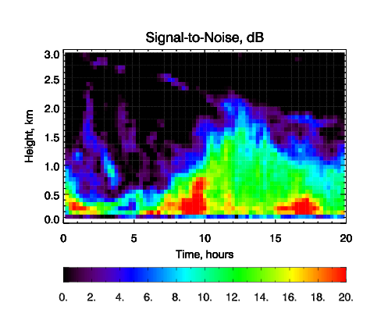
Radar wind profiler: growth of the atmospheric mixed layer
Radar signal-to-noise is a proxy for turbulence
Measurements are from a clear day in summer over land.
Note how thermals grow, increasing the depth of the mixed layer until early afternoon. This becomes the height of the boundary layer
Top of boundary layer
Mixed layer

Slide 10
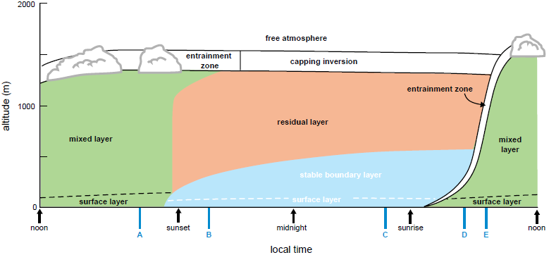
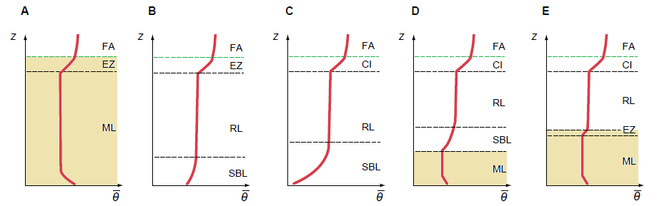
Evolution of boundary layer
After Markowski and Richardson 2010

Slide 11
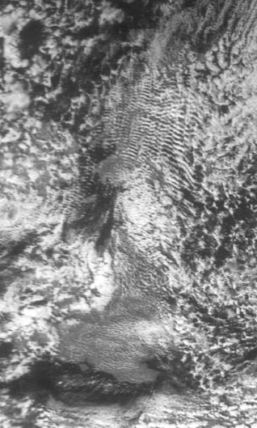
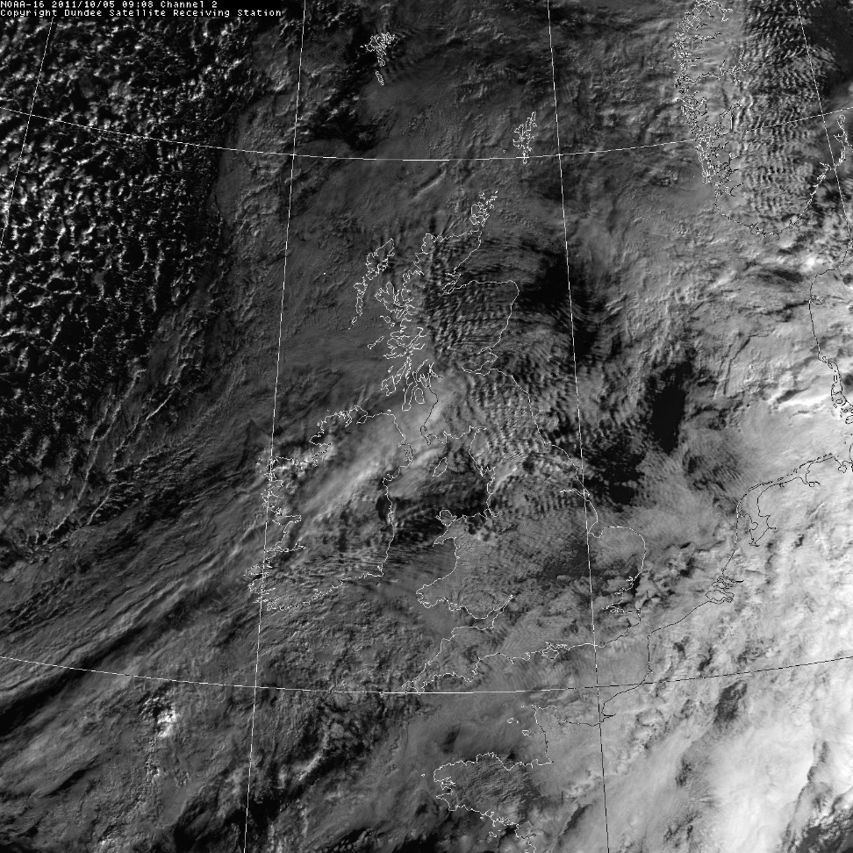
Lee waves

Slide 12
Formation of Lee waves
Flow over hill deflects upwards, creating cloud. Oscillations create lines of clouds.
$λ=Uτ=\frac{2πU}{N}$
~ 10 km for U = 20 ms⁻¹, $τ=10 min$
Cloud
Wind, U
λ
Hill

Slide 13
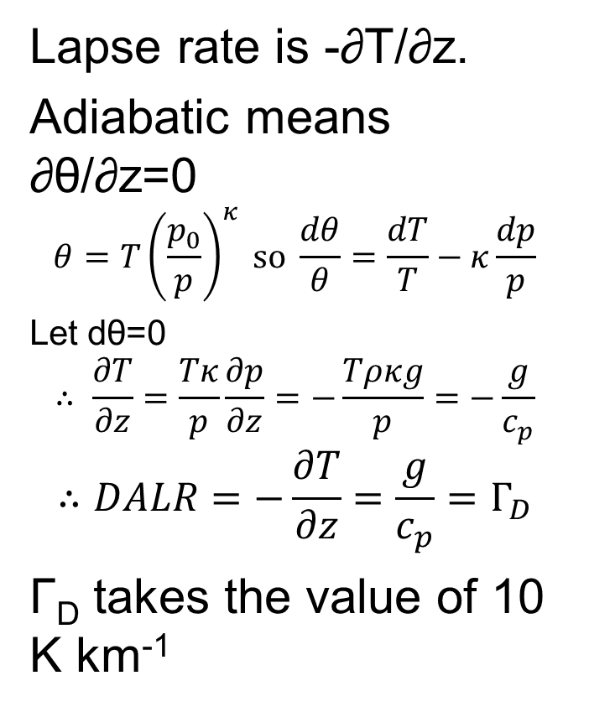
Dry adiabatic Lapse rate
Lapse rate is -∂T/∂z.
Adiabatic means ∂θ/∂z=0
$$θ=T{\left(\frac{p_{0}}{p}\right)}^{κ} so \frac{dθ}{θ}=\frac{dT}{T}−κ\frac{dp}{p}$$
Let dθ=0
$$∴ \frac{∂T}{∂z}=\frac{Tκ}{p}\frac{∂p}{∂z}=−\frac{Tρκg}{p}=−\frac{g}{c_{p}}$$
$$∴DALR=−\frac{∂T}{∂z}=\frac{g}{c_{p}}=Γ_{D}$$
Γ_{D} takes the value of 10 K km⁻¹
Usually, the lapse rate is 6-7 K km⁻¹ in the lower atmosphere – so the top of Snowdon would be around 6-7 K colder than in Caernarfon.

Slide 14
Lifting a parcel of air
Dry parcel
Temperature falls at 10 K km⁻¹
Moist parcel cools to saturation
Condensation releases latent heat so parcel then cools more slowly
z
z
Parcel lifted
Cloud forms
T
T

